Slide 1
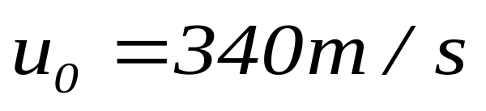
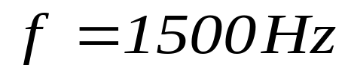
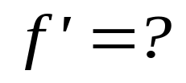

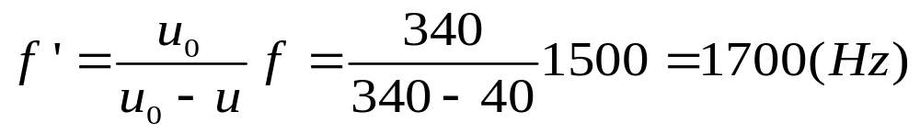
Example

Slide 2
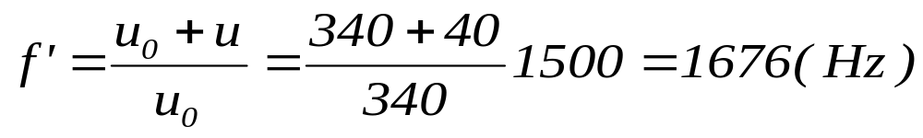
Example

Slide 3
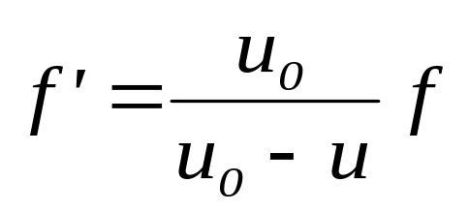
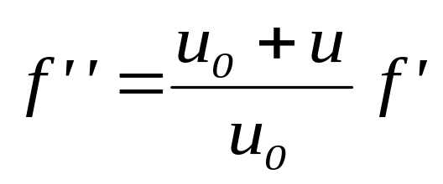
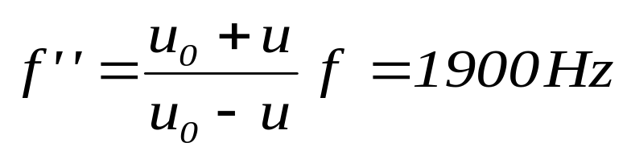
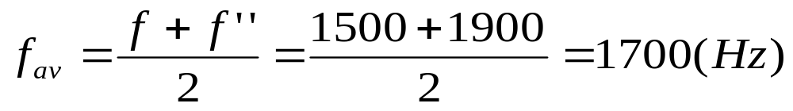

Example

Slide 4
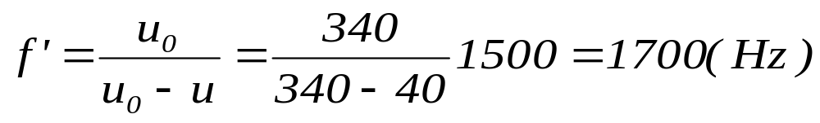
Example
Frame must be fixed with
material medium
Sound in material medium

Slide 5
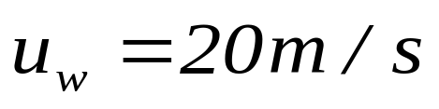


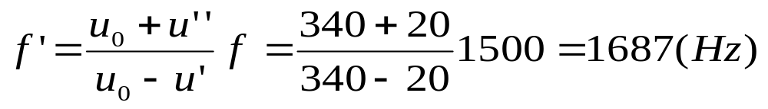
Example
Light wave
Frame must be fixed with
material medium
Sound in material medium
What is medium for light
aether

Slide 6
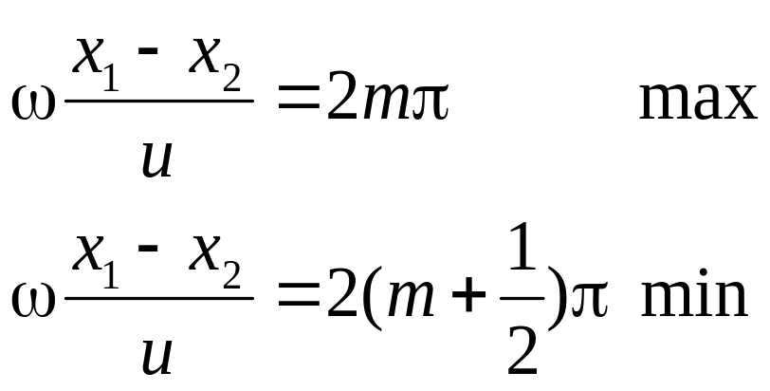
Michelson Interference

Slide 7

Michelson Interference
Light wave without
material medium
How can we
make a frame
no aether
What is the speed of the
light in different frame
There is no change
Troubles with classical physics

Slide 8
Chap. 20 The Special Theory of Relativity

Slide 9
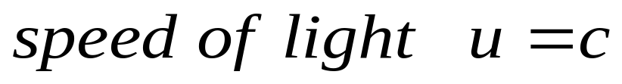
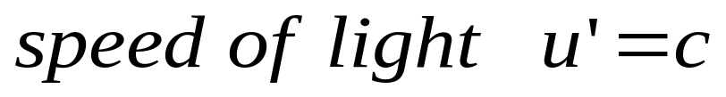
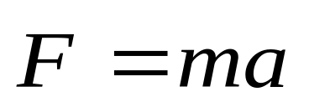
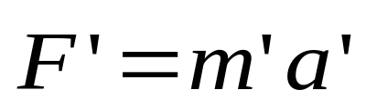


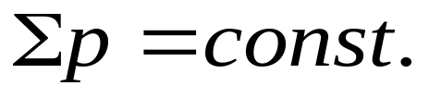
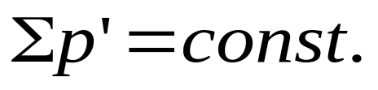
Einstein’s Postulates
y’
The postulates of special relativity
The speed of light in free space has same value c in all inertial reference frames.
y
r_{s’}
r_{s}
x’
o’
r_{ss’}
o
x
The laws of physics are the same in all inertial reference frames.

Slide 10
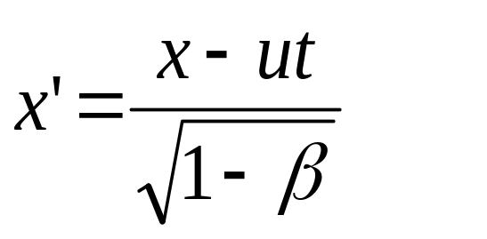
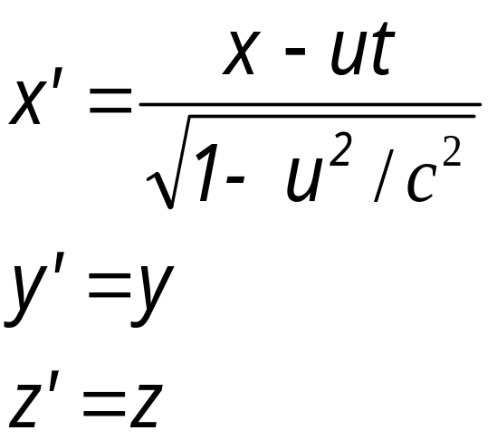
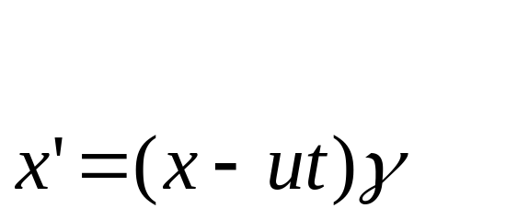
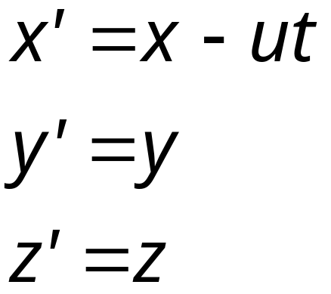
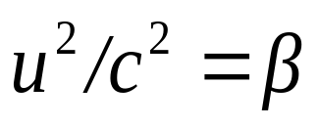
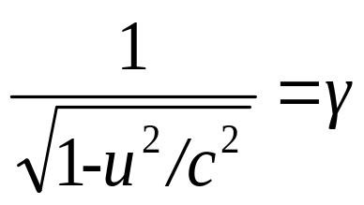
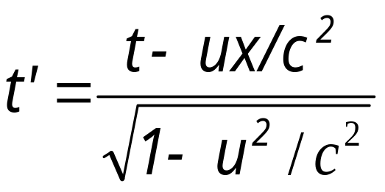
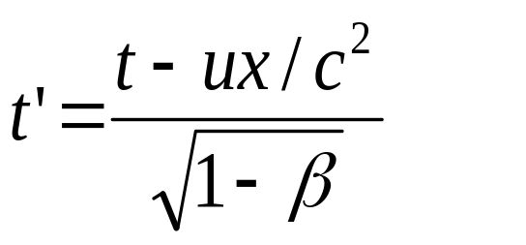
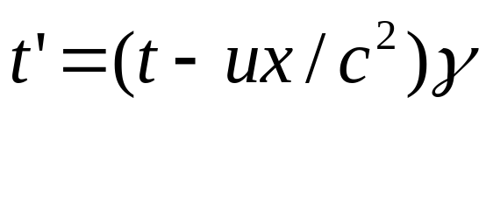
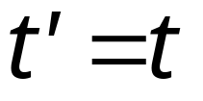
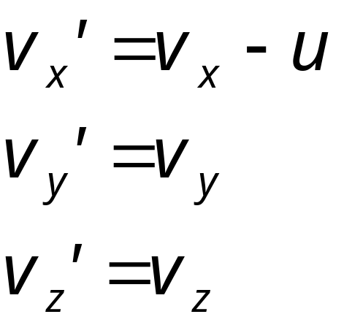
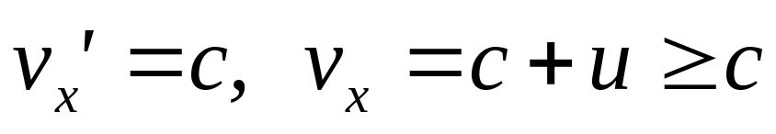
The Lorentz Transformation
Relative motion in 1-D
y
y’
u
x’
x
o
o’
Transformation is not correct

Slide 11
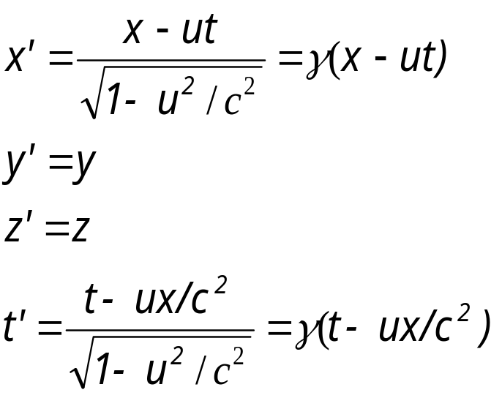
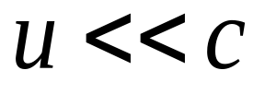
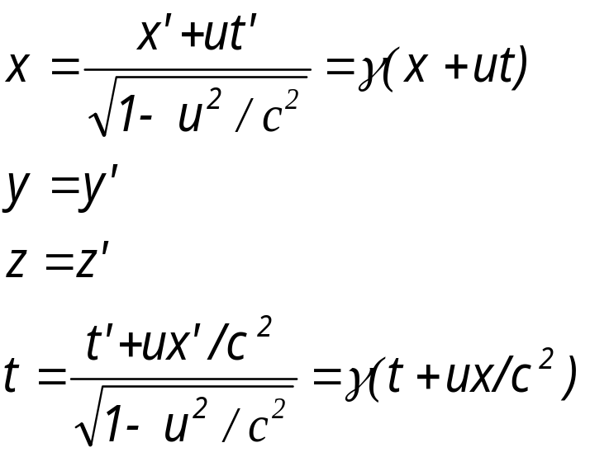
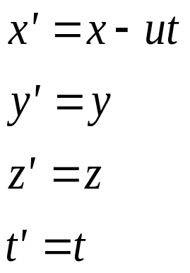
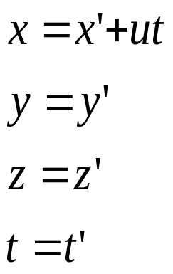
The Lorentz Transformation
Relative motion in 1-D
y
y’
u
x’
x
o
o’

Slide 12
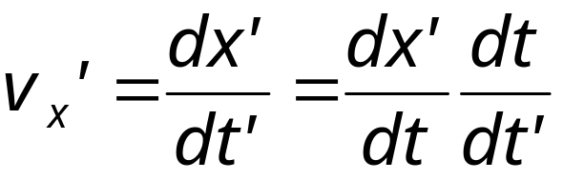
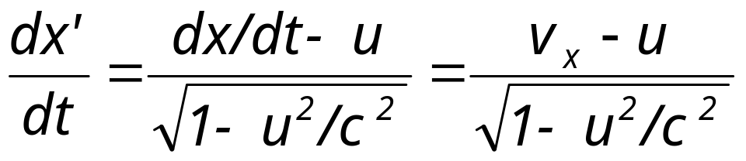
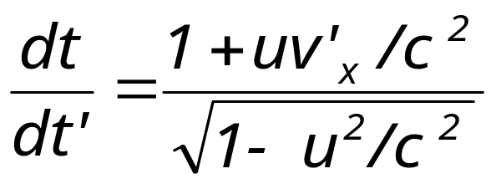
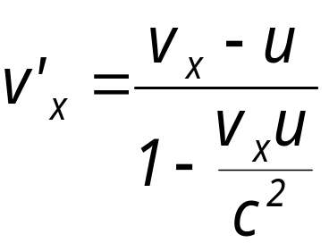
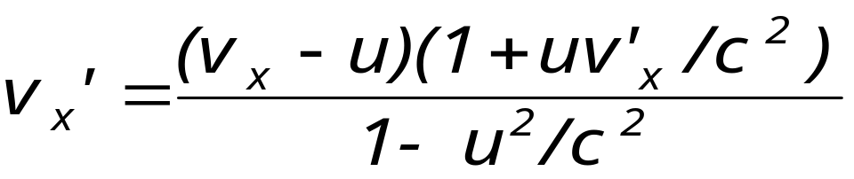
The Transformation of velocities
The Lorentz Transformation
Relative motion in 1-D
y
y’
u
o
o’
x’
x

Slide 13
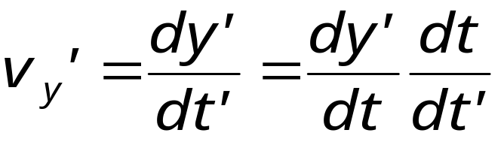
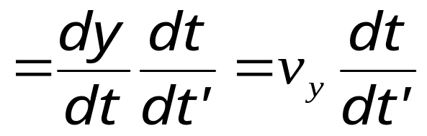

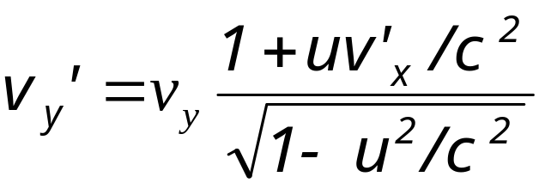
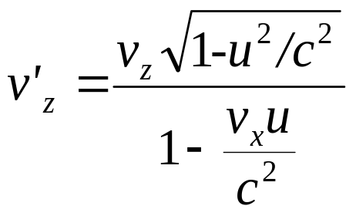
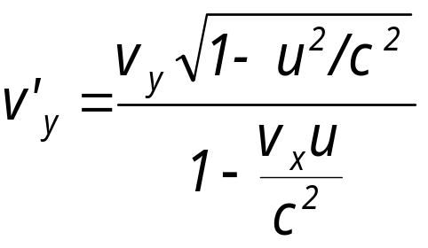
The Transformation of velocities
The Lorentz Transformation
Relative motion in 1-D
y
y’
u
o
o’
x’
x

Slide 14

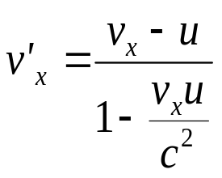
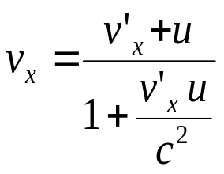

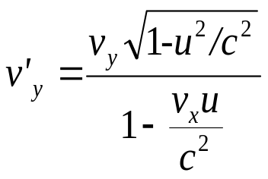
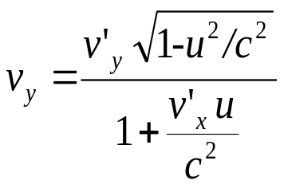



The Transformation of velocities
The Lorentz Transformation
Relative motion in 1-D
y
y’
u
o
o’
x’
x

Slide 15













Example
y
y’
c
u
o
o’
x’
x
The speed of light in free space has same value c in all inertial reference frames.

Slide 16




In s Frame x_{o} position
y
y’
u
x’
x
o
x_{o}
o’
Time longer

Slide 17




In s’ Frame x’_{o} position
y
y’
u
x’
x
o
o’
x’_{o}
Time longer

Slide 18




In s Frame x₁ and x₂ position
y
y’
u
x’
x
o
o’
x₁
x₂
Not at same time

Slide 19



In s’ Frame x’₁ and x’₂ position
y
y’
u
x’
x
o
o’
x’₁
x’₂
Not at same time

Slide 20




In s’ Frame L’=x’₁ –x’₂
In s Frame L=x₁ –x₂
y
y’
u
L’
x’
x
o
x’₁
x’₂
o’
Length reduces

Slide 21




In s Frame L=x₁ –x₂
In s’ Frame L’=?
y
y’
u
L
x’
o
x₁
x₂
o’
x
Length reduces

Slide 22














Example

Slide 23













Example

Slide 24
CHAP. 20 Exercises
P474 13, 15
P475 18, 19, 23

Slide 25
Einstein’s Postulates
y’
The postulates of special relativity
The speed of light in free space has same value c in all inertial reference frames.
y
r_{s’}
r_{s}
x’
o’
r_{ss’}
o
x
The laws of physics are the same in all inertial reference frames.

Slide 26


Relativistic Momentum
In S frame momentum is conservation
y
y
y
v
v
-v
v
-v
x
x
x
-v

Slide 27




In S’ Frame
y’
y’
u=-v
u=-v
x’
x’

Slide 28








In S’ Frame
y’
y’
u=-v
u=-v
In S’ frame momentum is not conservation
x
x’
The laws of physics are not same in all inertial reference frames.

Slide 29




Slide 30


In S frame
In S frame momentum is conservation
y
y
v
v
-v
x
x
-v

Slide 31












In S’ Frame
y’
y’
u=-v
u=-v
x’
x’
The laws of physics are the same in all inertial reference frames.
In S’ frame momentum is conservation

Slide 32


Relativistic Energy
In S frame energy is conservation
y
y
v
v
-v
x
x
-v

Slide 33





In S’ Frame
y’
y’
u=-v
u=-v
x’
x’
In S’ frame energy is not conservation

Slide 34






If m is not constant

Slide 35








Total energy
Kinetic energy
Rest energy

Slide 36

In S frame
In S frame energy is conservation
y
y
v
v
-v
x
x
-v

Slide 37






In S’ Frame
In S’ frame energy is conservation
y’
y’
u=-v
u=-v
x’
x’

Slide 38



summary

Slide 39







Momentum and Energy

Slide 40





Momentum and Energy

Slide 41











Slide 42




Time is constant
Speed of light is constant
Mass is constant
Time is not constant
Mass is not constant

Slide 43








Slide 44










Slide 45
CHAP. 20
Exercises
P475 36, 37 P476 40, 42
Problems
P477 13

Slide 46
Einstein’s Postulates
y’
The postulates of special relativity
The speed of light in free space has same value c in all inertial reference frames.
y
r_{s’}
r_{s}
x’
o’
r_{ss’}
o
x
The laws of physics are the same in all inertial reference frames.

Slide 47






y
y’
The Lorentz Transformation
Relative motion in 1-D
u
The Transformation of velocities
o
o’
x’
x
Length reduces
Time longer
The speed of light in free space has same value c in all inertial reference frames

Slide 48







Example

Slide 49







Example

Slide 50


















Example

Slide 51





The laws of physics are the same in all inertial reference frames

Slide 52







Example

Slide 53


Example

Slide 54












Example

Slide 55
Einstein’s Postulates
y’
The postulates of special relativity
The speed of light in free space has same value c in all inertial reference frames.
y
r_{s’}
r_{s}
x’
o’
r_{ss’}
o
x
The laws of physics are the same in all inertial reference frames.

